Slide 1
HBase
Gaurav Ojha

Slide 2
Hbase and HDFS
HBase and HDFS (Hadoop Distributed File System) are both components of the Apache Hadoop software framework, designed for the processing of large data sets in a distributed computing environment. However, they serve different purposes and have different characteristics.

Slide 3
hdfs
HDFS (Hadoop Distributed File System): HDFS is a distributed file system designed to store very large files across multiple machines in a reliable and fault-tolerant manner. It provides high throughput access to application data and is suitable for applications with large data sets. HDFS is highly fault-tolerant and is designed to be deployed on low-cost hardware. It is ideal for batch processing where data is written once and read multiple times.

Slide 4
Hbase
HBase: HBase is a NoSQL database that runs on top of Hadoop. It is a distributed, scalable, big data store that provides real-time read/write access to large datasets. HBase is designed to handle large amounts of sparse data with billions of rows and millions of columns, and it is well-suited for random, real-time read/write access patterns. HBase is often used for applications that require random, real-time read/write access to large datasets, such as sensor data, time series data, and messaging systems.

Slide 5
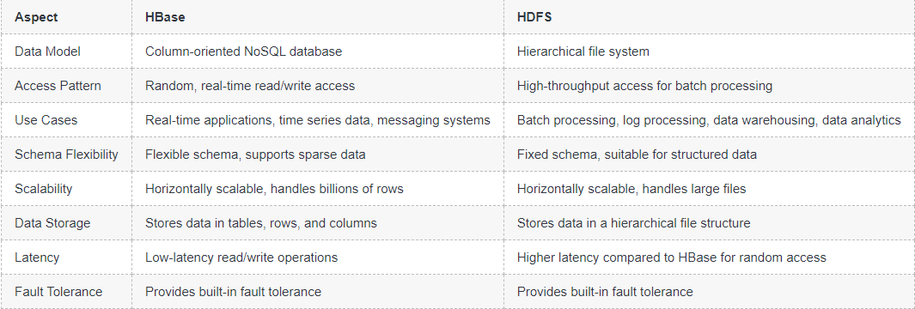
Hbase vs hdfs

